Slide 1
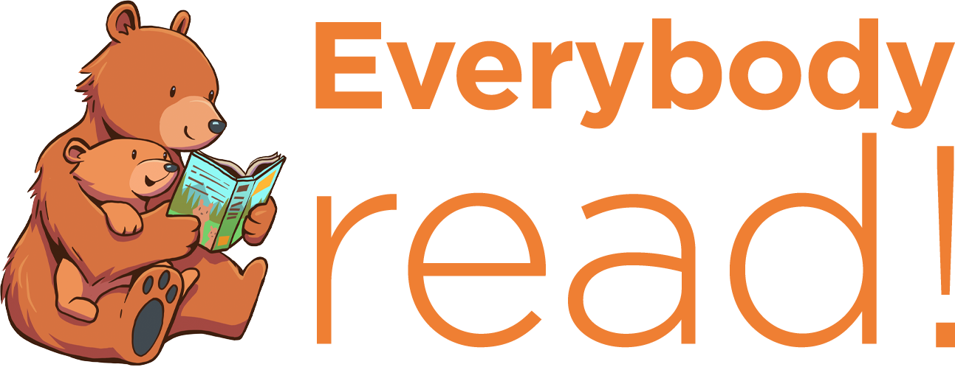
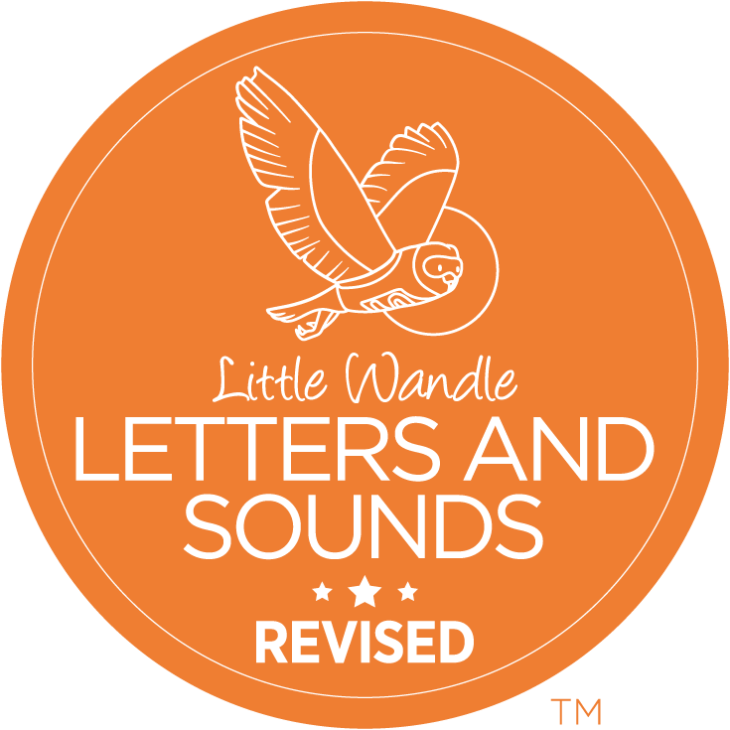
Why reading to your child really matters

Slide 2
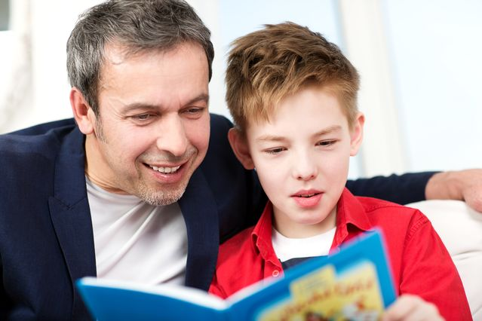
Why read with your child at home?
Reading a book and chatting about it has a positive impact on children’s ability to:
understand words and sentences
use a wide range of vocabulary
develop listening comprehension skills
Parental involvement in the development of children’s reading skills: A five-year longitudinal study (2002) Senechal, M. and Lefvre, J.

Slide 3
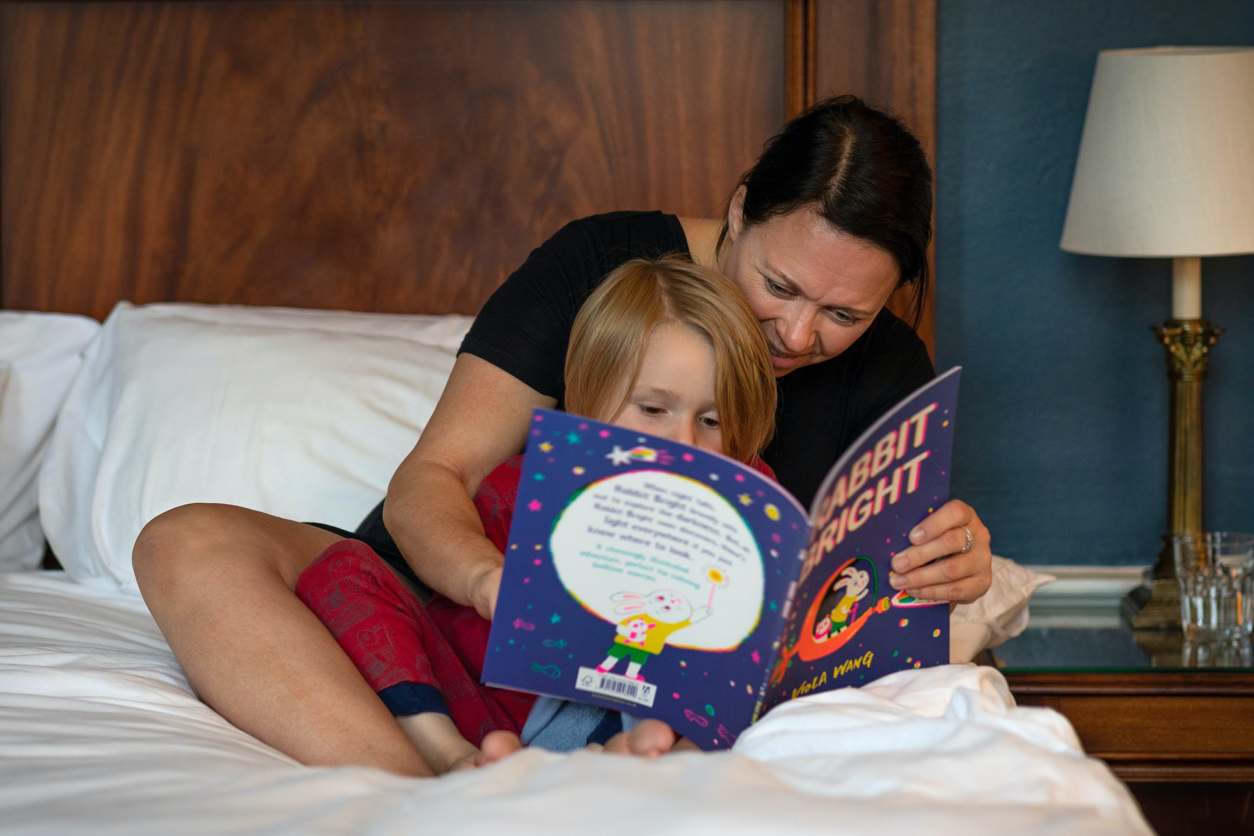
Why does reading together every day matter?
The number of books your child has encountered by the age of six is a
positive predictor of their reading
ability two years later.
This benefit comes from:
Adults reading to children and children enjoying books simply by looking at them and talking about them.
Parental involvement in the development of children’s reading skills: A five-year longitudinal study (2002) Senechal, M. and Lefvre, J.

Slide 4
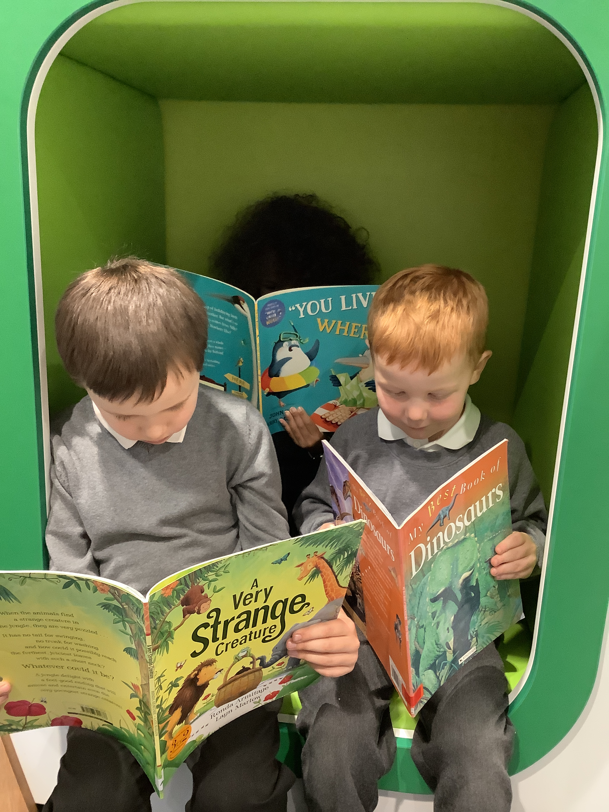
Does it matter how we read with our children?
Studies show that it’s the enjoyment and chat that matters!
The more you chat together about the book and things that interest your child, the more impact it has.
You don’t even have to read the words on the page – talking about the pictures is just as important.
If you can read the words, then use your voice to make them come alive. It will help your child understand the book even better.

Slide 5

Does it matter which language we use?
Use your home language.
It is better for your child to hear expert talk from you in your language.
Many studies tell us it is the back-and-forth talk between adults and children when they are sharing books that makes the difference to children’s language and comprehension.
This impact will translate to better language and comprehension for your child in English.

Slide 6
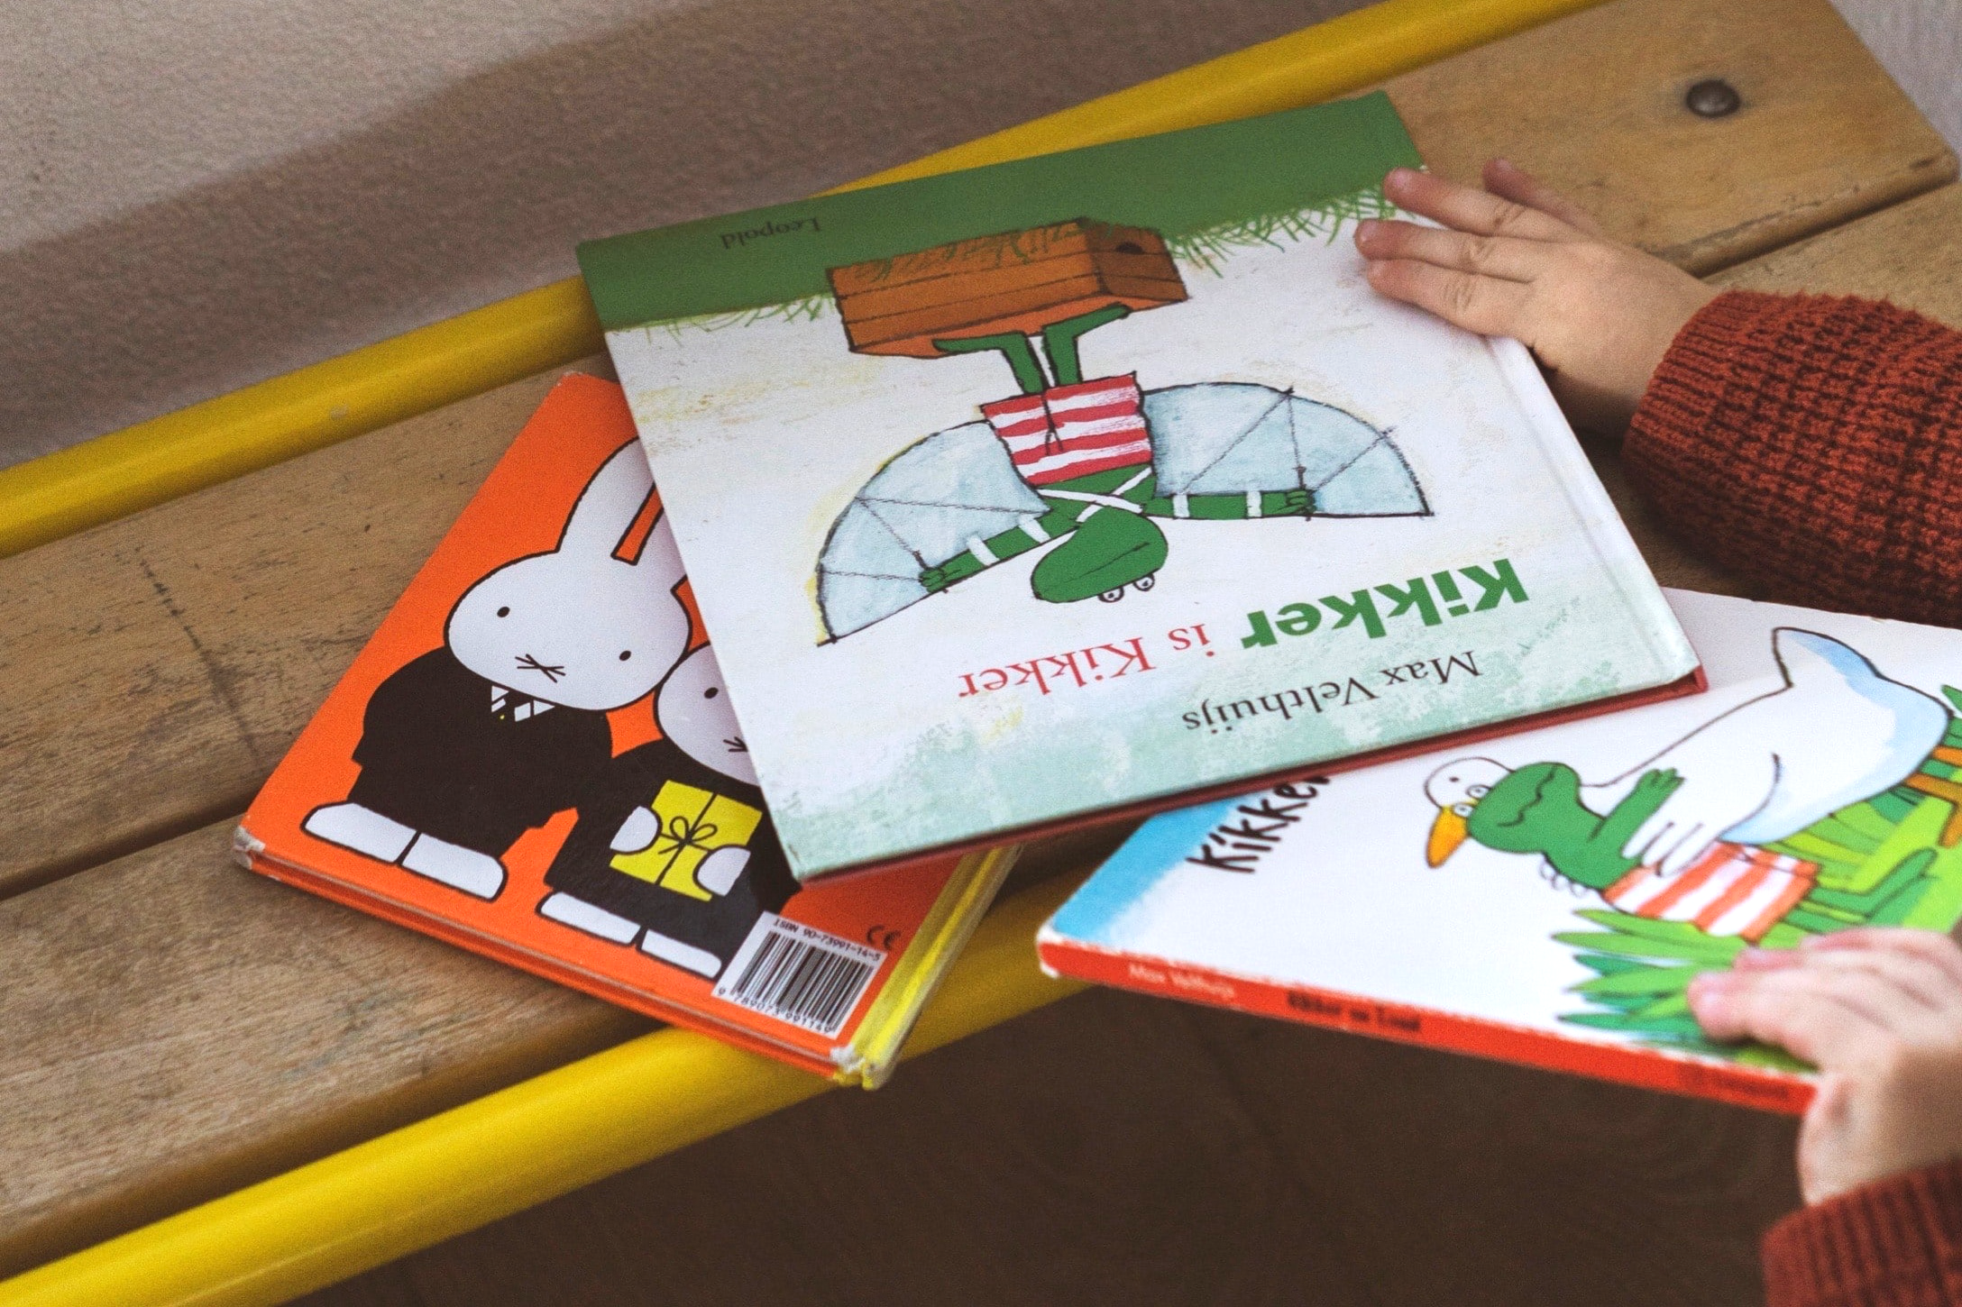
Does the type of book matter?
Let your child be the boss of the books they choose. Enjoyment really matters.
Comics, information books, magazines, story books, picture books, poems and leaflets are all great for sharing.
Catalogues are fun to share and talk about too.

Slide 7
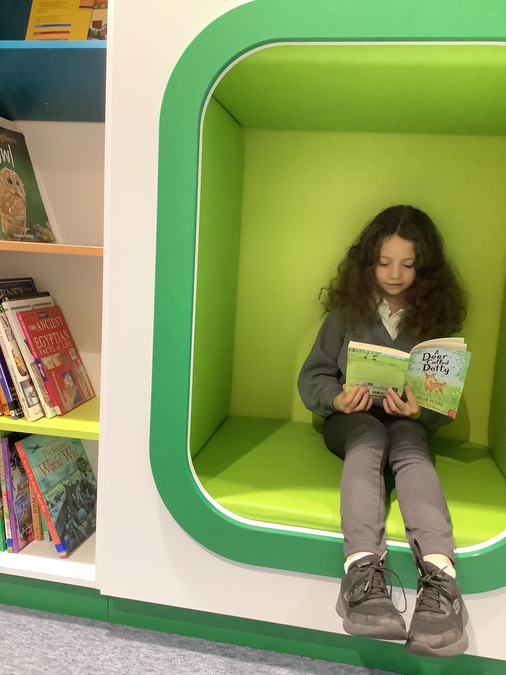
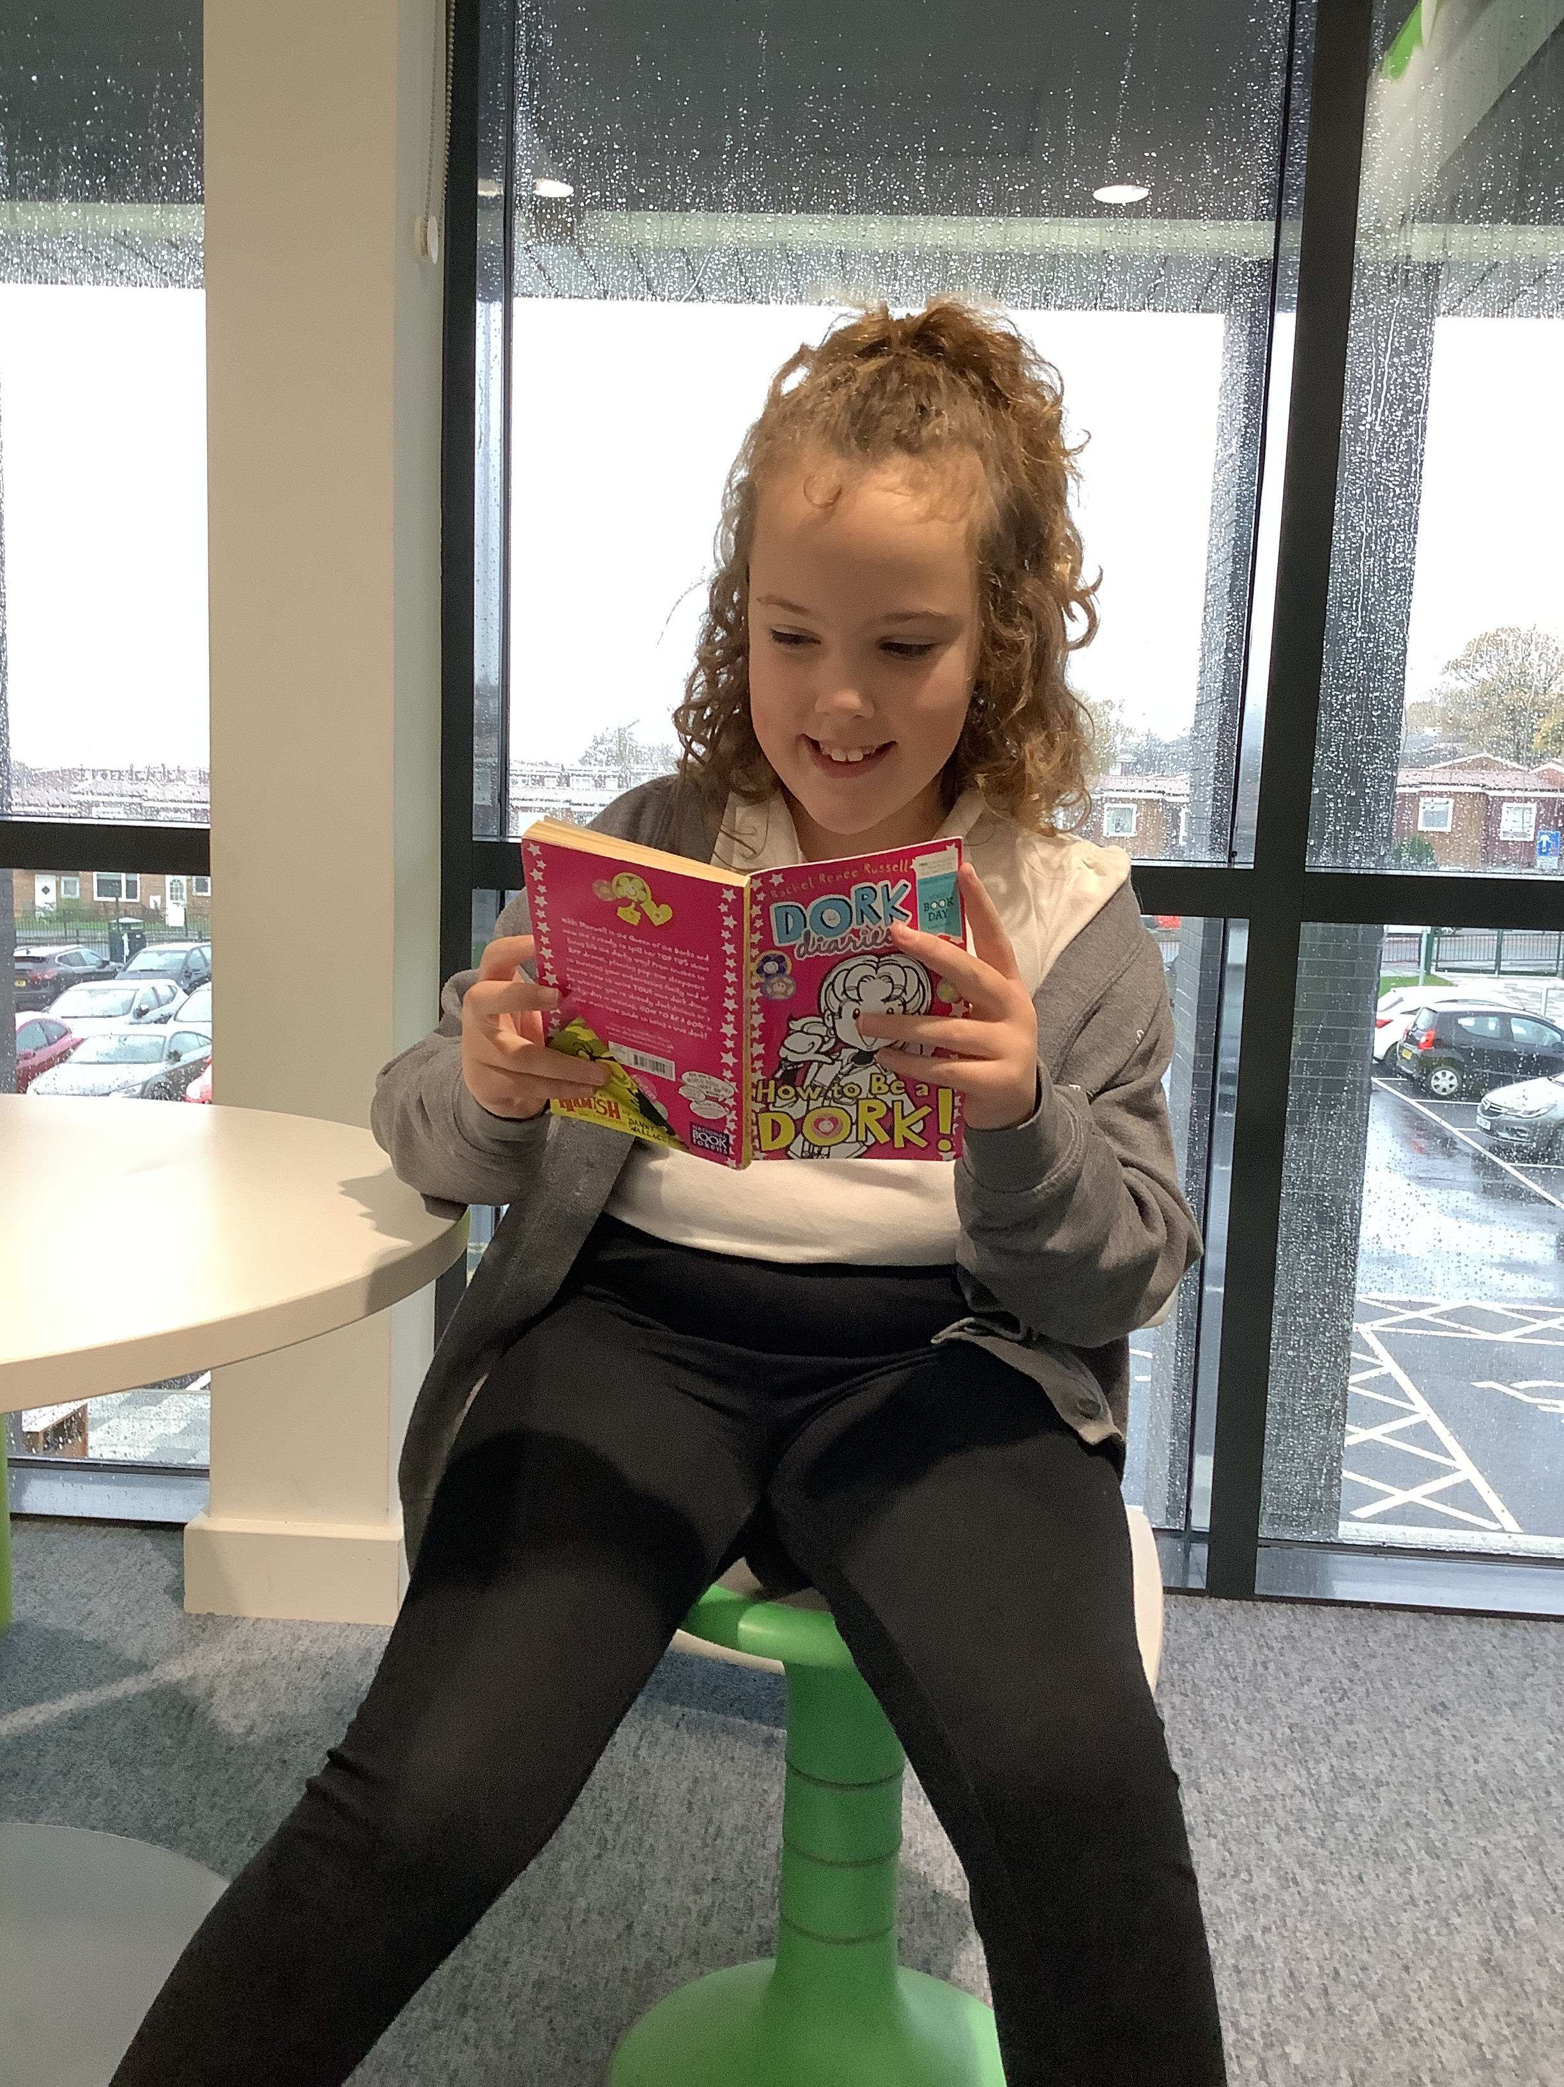
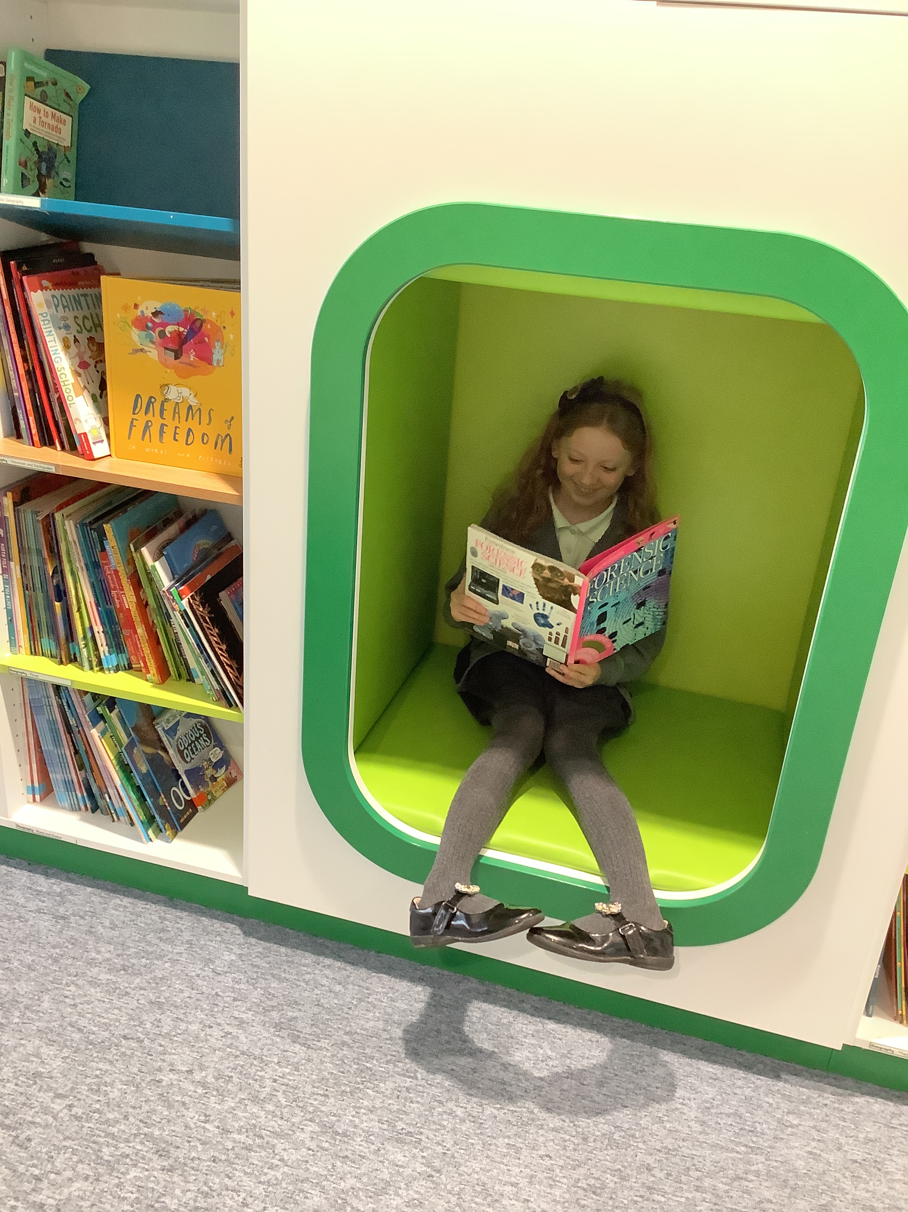
What if they always want to read the same book?
Repeated reading of books is really beneficial for children. It helps them memorise parts of stories, words and phrases too.
Knowing a book or poem by heart is fun and powerful for children, they can ‘read’ the story with you, or join in with words of phrases.
If you really want to mix it up, offer another book alongside the much-loved favourite!

Slide 8
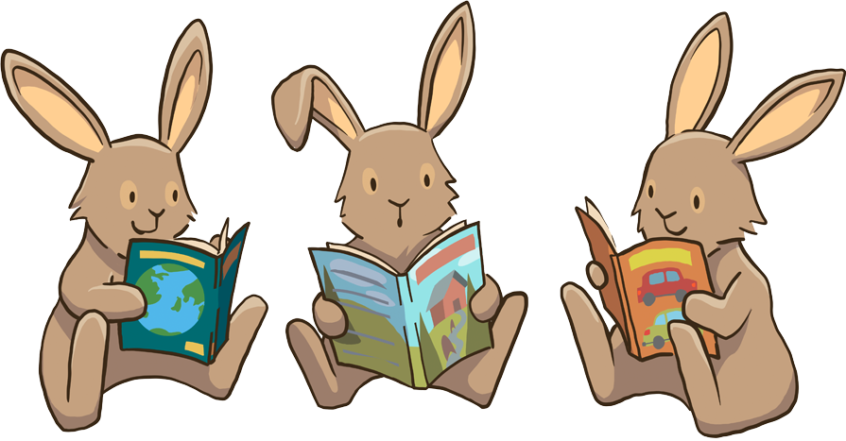
A love of reading is the biggest indicator of future academic success!

